Slide 1


Angular
Aruna S
Department of
Computer Science and Engineering

Slide 2

angular
Angular Components
S. Aruna
Department of Computer Science and Engineering

Slide 3
Angular
Decorators
Here’s the list of decorators available in Angular:
@NgModule
@Component
@Injectable
@Directive
@Pipe
@Input
@Output
@HostBinding
@HostListener
@ContentChild
@ContentChildren
@ViewChild
@ViewChildren

Slide 4
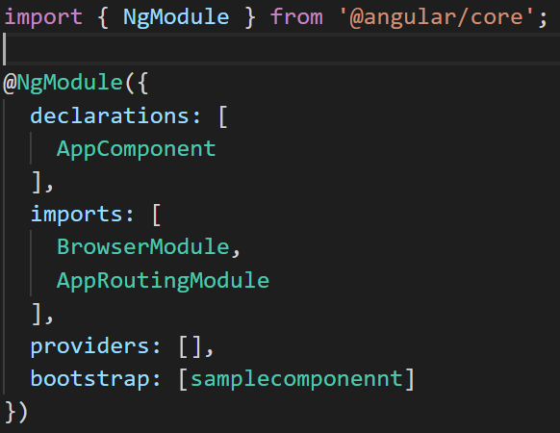
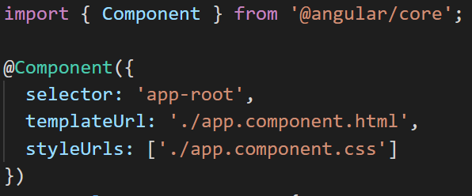
Angular
Decorators
@NgModule:
Defines a module that contains components, directives, pipes, and providers.
@Component:
Declares that a class is a component and provides metadata about the component.

Slide 5
Angular
Components
User Inputs
Component Lifecycle
Component Interaction
Component Styles
Inputs and Outputs

Slide 6
Angular
Components
User Inputs

Slide 7
Angular
Components – User Inputs
User actions such as clicking a link, pushing a button, and entering text raise DOM events.
Use Angular event bindings to respond to any DOM event. Many DOM events are triggered by user input.
To bind to a DOM event, surround the DOM event name in parentheses and assign a quoted template statement to it.
For example:
The (click) to the left of the equals sign identifies the button's click event as the target of the binding. The text in quotes to the right of the equals sign is the template statement, which responds to the click event by calling the component's onClickMe method.

Slide 8
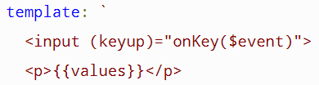
Angular
Components - User Inputs
Get user input from the $event object
DOM events carry a payload of information that may be useful to the component
For example:
bind to the keyup event of an input box to get the user's input after each keystroke.
Get user input from a template reference variable
Key event filtering (with key.enter)

Slide 9
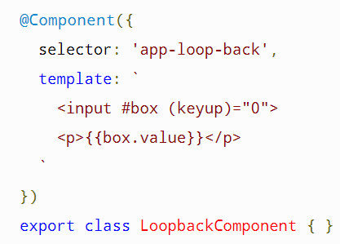
Angular
Components – User Inputs
Get user input from a template reference variable and Key event filtering (with key.enter)
Use Angular template reference variables to get the user data.
These variables provide direct access to an element from within the template.
To declare a template reference variable, precede an identifier with a hash (or pound) character (#).
The following snapshot uses a template reference variable to implement a keystroke loopback in a simple template.

Slide 10
Angular
Components
Component Lifecycle

Slide 11
Angular
Components - Lifecycle
A component instance has a lifecycle that starts when Angular instantiates the component class and renders the component view along with its child views.
The lifecycle continues with change detection, as Angular checks to see when data-bound properties change, and updates both the view and the component instance as needed.
The lifecycle ends when Angular destroys the component instance and removes its rendered template from the DOM
Angular provides eight interfaces to implement those as component goes from creation to destruction phases.

Slide 12
Angular
Components – Life Cycle
ngOnInit(): This is called when the component is loaded into the DOM and it occurs only once.
ngOnChanges(): This is called when there is Input property to the component and it is called before ngOnInit() and occurs every time there is a change in the input property. It is not called if there is no input property to the component
ngDoCheck(): occurs every time there is a change detection and immediately after ngOnChanges() and ngOnInit().
ngOnDestroy(): This is called right before the component gets destroyed and occurs only once.

Slide 13
Angular
Components - Lifecycle
ngAfterViewInit(): This is called once after the component’s view/ child views are loaded and right after ngAfterContentChecked() and occurs only once.
ngAfterViewChecked(): This is called after component’s view/ child views are loaded and called after ngAfterViewInit() and every time after ngDoCheck().
ngAfterContentInit(): This is called once external content is projected into component’s view and right after the first ngDoCheck() and occurs only once.
ngAfterContentChecked(): This is called after external content projected into component’s view and called after ngAfterContentInit() and every subsequent ngDoCheck().

Slide 14
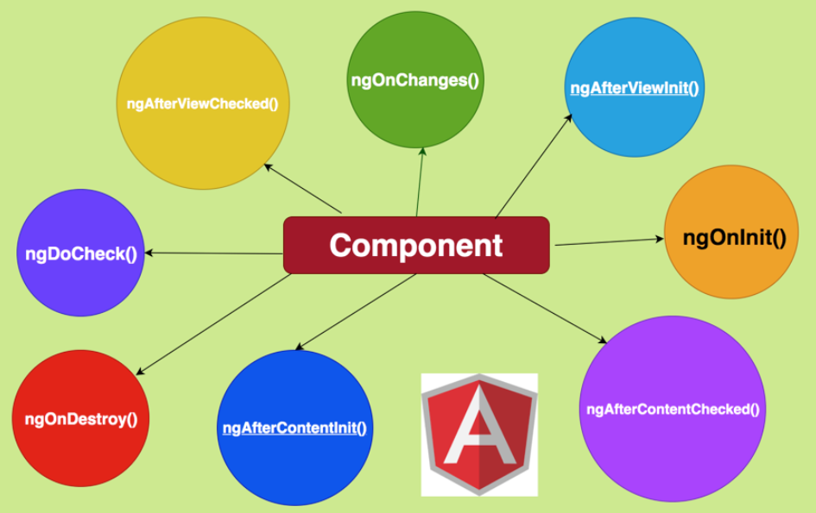
Angular
Component - Lifecycle Hooks

Slide 15
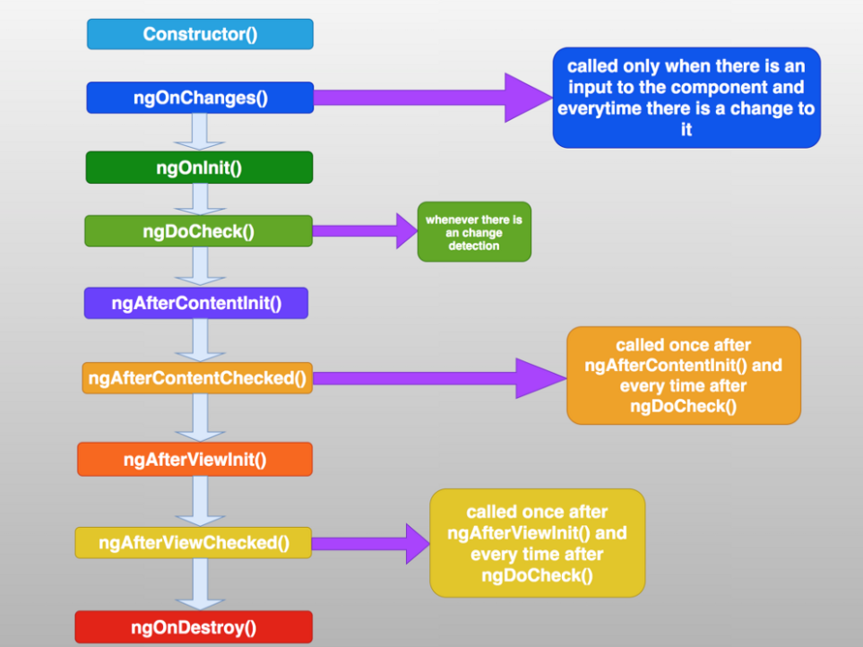
Angular
Component - Angular Lifecycle Hooks Order

Slide 16
Angular
Components
Inputs and Outputs

Slide 17
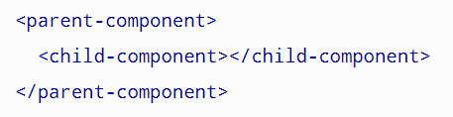
Angular
Components – Inputs and Outputs
@Input() and @Output() allow Angular to share data between the parent context and child directives or components.
An @Input() property is writable while an @Output() property is observable.
Here, the <child-component> selector, or child directive, is embedded within a <parent-component>, which serves as the child's context.
@Input() and @Output() act as the API, or application programming interface, of the child component in that they allow the child to communicate with the parent.

Slide 18
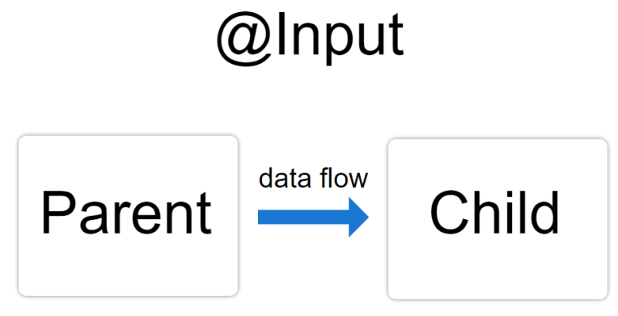
Angular
Components – @Input()
@Input() is the doorway into the component allowing data to flow in while @Output() is the doorway out of the component, allowing the child component to send data out.
Use the @Input() decorator in a child component or directive to let Angular know that a property in that component can receive its value from its parent component.
It helps to remember that the data flow is from the perspective of the child component.
@Input() allows data to be input into the child component from the parent component.

Slide 19
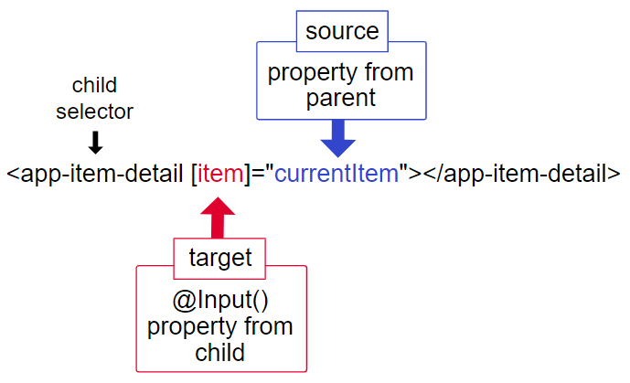
Angular
Components – @Input()
The target in the square brackets, [], is the property you decorate with @Input() in the child component.
The binding source, the part to the right of the equal sign, is the data that the parent component passes to the nested component.

Slide 20
Angular
Components – @Output()
Use the @Output() decorator in the child component or directive to allow data to flow from the child out to the parent.
An @Output() property should normally be initialized to an Angular EventEmitter with values flowing out of the component as events.
use @Output() on a property of the child component but its type should be EventEmitter.

Slide 21
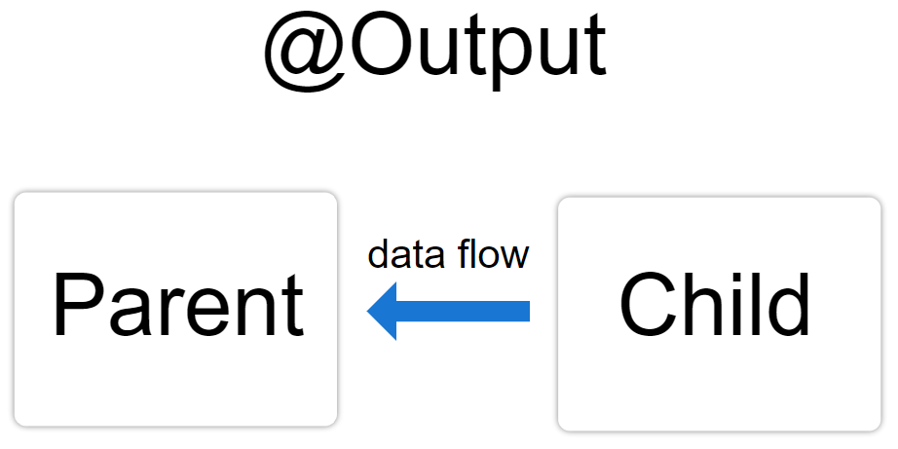
Angular
Components – @Output()
@Output() marks a property in a child component as a doorway through which data can travel from the child to the parent.
The child component then has to raise an event so the parent knows something has changed.
To raise an event, @Output() works hand in hand with EventEmitter, which is a class in @angular/core that you use to emit custom events.

Slide 22
Angular
Components
Component Styles

Slide 23
Angular
Components – @Output()
Angular applications are styled with standard CSS.
Additionally, Angular can bundle component styles with components, enabling a more modular design than regular stylesheets.
For every Angular component you write, you may define not only an HTML template, but also the CSS styles that go with that template, specifying any selectors, rules, and media queries that you need.

Slide 24
Angular
Components – Loading component styles
There are several ways to add styles to a component:
By setting styles or styleUrls metadata.
Inline in the template HTML.
With CSS imports.

Slide 25
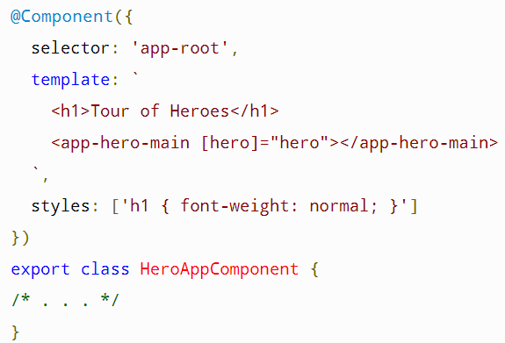
Angular
Components – Styles in component metadata
You can add a styles array property to the @Component decorator.
Each string in the array defines some CSS for this component.
The styles specified in @Component metadata apply only within the template of that component.
They are not inherited by any components nested within the template nor by any content projected into the component.

Slide 26
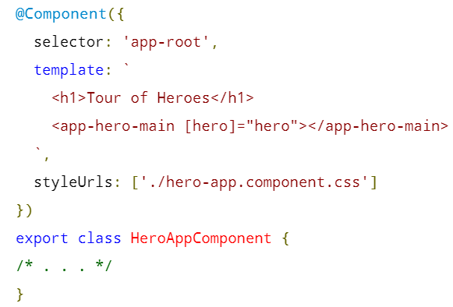
Angular
Components – Style files in component metadata
You can load styles from external CSS files by adding a styleUrls property to a component's @Component decorator
The styles in the style file apply only to this component. They are not inherited by any components nested within the template nor by any content projected into the component.

Slide 27
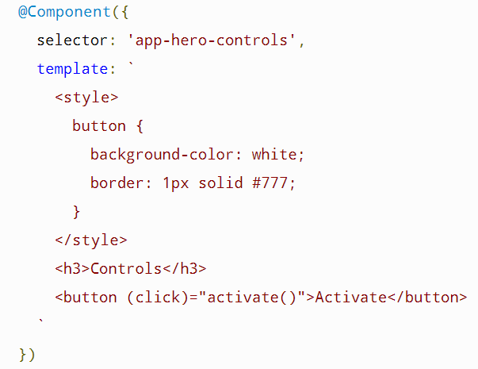
Angular
Components – Template inline styles
You can embed CSS styles directly into the HTML template by putting them inside <style> tags.

Slide 28
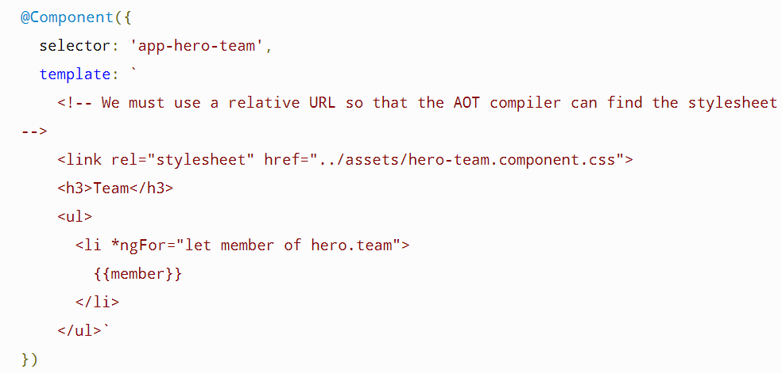
Angular
Components – Template Link Tags
You can also write <link> tags into the component's HTML template.

Slide 29
Angular
Components
Component Interaction

Slide 30
Angular
Templates
In Angular, a template is a chunk of HTML. Within a template, you can use special syntax to leverage many of Angular's features.
Each Angular template in your app is a section of HTML that you can include as a part of the page that the browser displays. An Angular HTML template renders a view, or user interface, in the browser, just like regular HTML, but with a lot more functionality.
When you generate an Angular app with the Angular CLI, the app.component.html file is the default template containing placeholder HTML.
The template syntax guides show you how you can control the UX/UI
by coordinating data between the class and the template.

Slide 31
Angular
Templates Syntax
Almost all HTML syntax is valid template syntax. However, because an Angular template is part of an overall webpage, and not the entire page, you don't need to include elements such as <html>, <body>, or <base>. You can focus exclusively on the part of the page you are developing.
To eliminate the risk of script injection attacks, Angular does not support the <script> element in templates. Angular ignores the <script> tag and outputs a warning to the browser console.

Slide 32
Angular
Templates Syntax
Interpolation—learn how to use interpolation and expressions in HTML.
Template statements—respond to events in your templates.
Binding syntax—use binding to coordinate values in your app.
Property binding—set properties of target elements or directive @Input() decorators.
Attribute, class, and style bindings—set the value of attributes, classes, and styles.
Event binding—listen for events and your HTML.
Two-way binding—share data between a class and its template.

Slide 33


Angular
Templates – Interpolation {{...}}
Interpolation allows you to incorporate calculated strings into the text between HTML element tags and within attribute assignments.
Template expressions are what you use to calculate those strings.
Interpolation refers to embedding expressions into marked up text.
By default, interpolation uses as its delimiter the double curly braces, {{ and }}.
In the following snippet, {{ currentCustomer }} is an example of interpolation.
Template Expressions:

Slide 34
Angular
Templates – Template Expressions
Template statements are methods or properties that you can use in your HTML to respond to user events. With template statements, your application can engage users through actions such as displaying dynamic content or submitting forms.
In the following example, the template statement deleteHero() appears in quotes to the right of the = symbol as in (event)="statement".
When the user clicks the Delete hero button, Angular calls the deleteHero() method in the component class.
You can use template statements with elements, components, or directives in response to events.

Slide 35
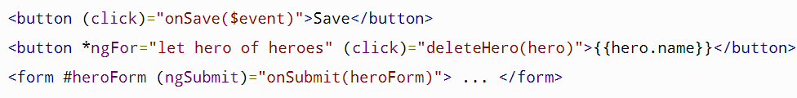
Angular
Templates – Statement Context
Template Statements have a context—a particular part of the application to which the statement belongs.
Statements can refer only to what's in the statement context, which is typically the component instance.
For example, deleteHero() of (click)="deleteHero()" is a method of the component in the following snippet.
The statement context may also refer to properties of the template's own context. In the following example, the component's event handling method, onSave() takes the template's own $event object as an argument.

Slide 36
Angular
Templates – Statement Context
On the next two lines, the deleteHero() method takes a template input variable, hero, and onSubmit() takes a template reference variable, #heroForm.
In this example, the context of the $event object, hero, and #heroForm is the template

Slide 37
THANK YOU
Aruna S
Department of
Computer Science and Engineering
arunas@pes.edu

